Slide 1
Section 6.6
Logarithmic and
Exponential Equations
Copyright © 2012 Pearson Education, Inc. Publishing as Prentice Hall.

Slide 2

Copyright © 2012 Pearson Education, Inc. Publishing as Prentice Hall.

Slide 3
Recall:
Copyright © 2012 Pearson Education, Inc. Publishing as Prentice Hall.

Slide 4

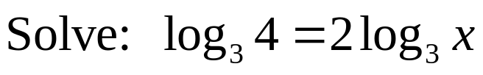
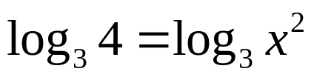




Reminder: The domain of logarithmic functions is positive numbers only so check for extraneous solutions.
Copyright © 2012 Pearson Education, Inc. Publishing as Prentice Hall.

Slide 5
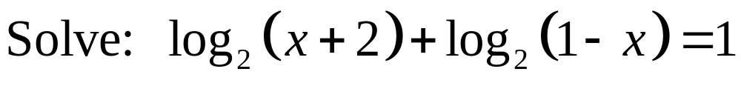
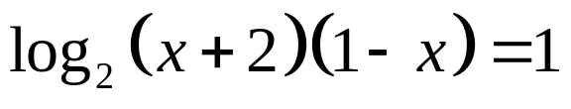

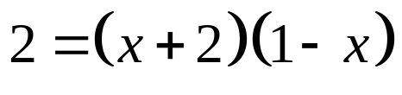



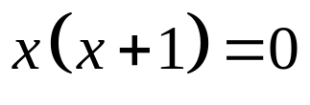

Both solutions are in the domain of the log functions.
Copyright © 2012 Pearson Education, Inc. Publishing as Prentice Hall.

Slide 6

Copyright © 2012 Pearson Education, Inc. Publishing as Prentice Hall.

Slide 7
Recall:
Copyright © 2012 Pearson Education, Inc. Publishing as Prentice Hall.

Slide 8
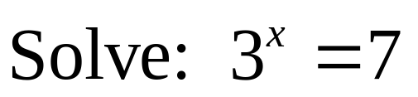
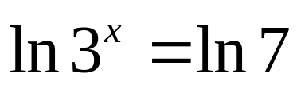


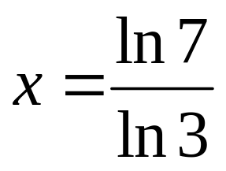
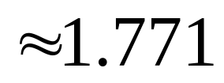
Copyright © 2012 Pearson Education, Inc. Publishing as Prentice Hall.

Slide 9
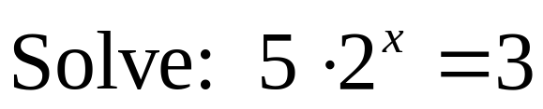
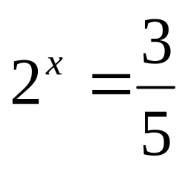
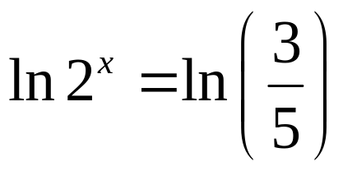
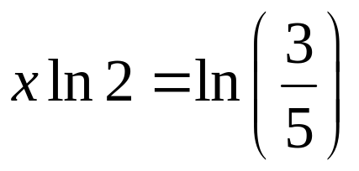
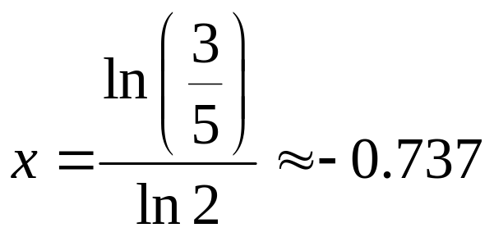
Copyright © 2012 Pearson Education, Inc. Publishing as Prentice Hall.

Slide 10
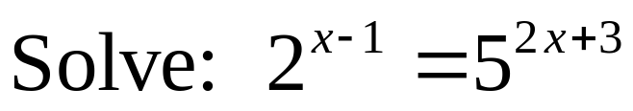

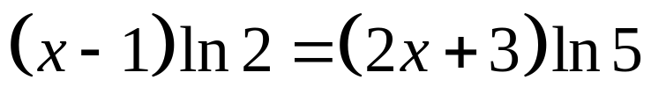


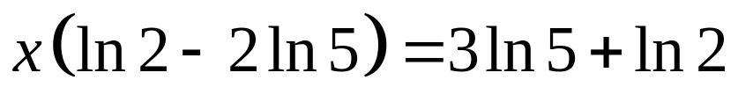
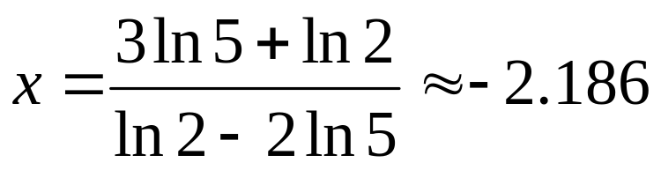
Copyright © 2012 Pearson Education, Inc. Publishing as Prentice Hall.

Slide 11
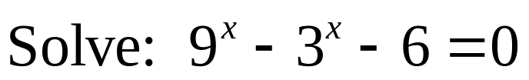
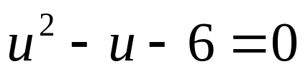

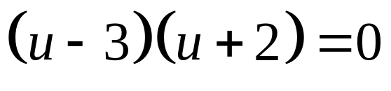

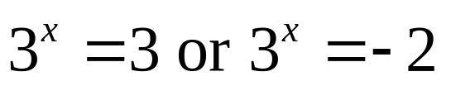


Copyright © 2012 Pearson Education, Inc. Publishing as Prentice Hall.

Slide 12

Copyright © 2012 Pearson Education, Inc. Publishing as Prentice Hall.

Slide 13

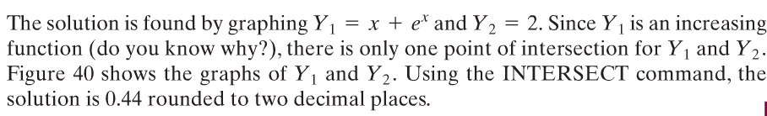
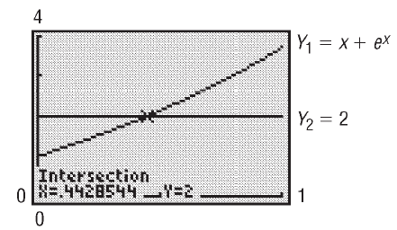
Copyright © 2012 Pearson Education, Inc. Publishing as Prentice Hall.
Figure 40

